Slide 1

Quick start guide

Slide 2
Topics to cover
What is Docker & Kubernetes ?
Kubernetes Architecture.
Local setup of Kubernetes.
Working with Kubernetes.
Helm charts.
Develop and deploy Spring boot-Kubernetes application.

Slide 3
What is Kubernetes ?
Open Source Container Orchestration Tool.
Developed by Google.
Can deploy in physical, virtual, cloud or Hybrid Environments.
High Availability – No Down time
Scalability – High Performance
Resiliency – Back up and Restore

Slide 4
Docker Vs Kubernetes
Container runtime, Isolated Environment for App
Build image and push on Repo
Infrastructure for managing multiple container
Get Images from Repo and Build multiple managed Containers
Can work with many container runtime ex. Docker, CRI-O, Rocket.

Slide 5
What Kubernetes Can do ?
Create and Monitor Container across Cluster
Continuously Health Check
Automatically Restart Failed Container
Remove unresponsive Container
Release an Update
Load Balancing
Handle Storage for Container data
Administrative intelligence (optimize use as per available resource)

Slide 6
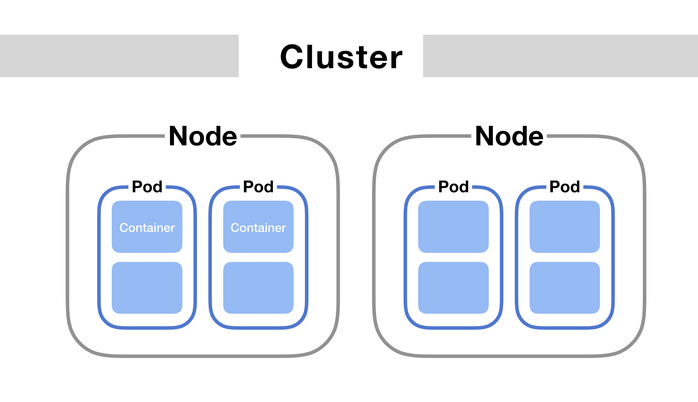
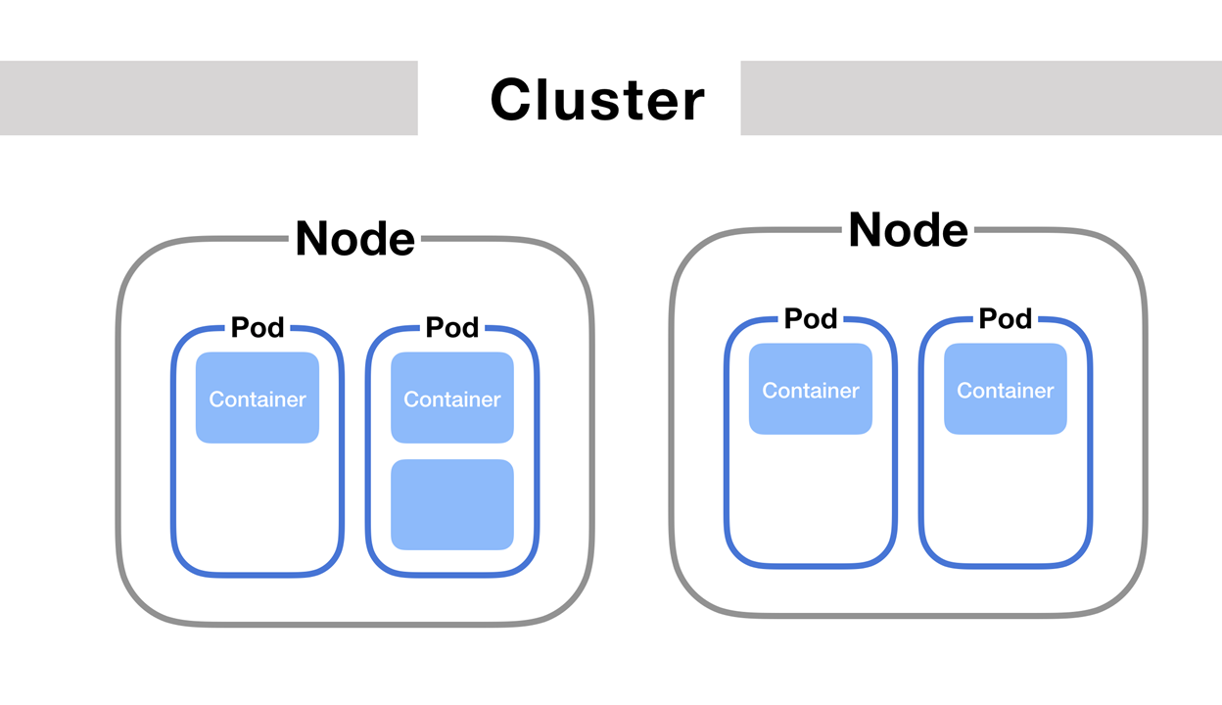

Slide 7
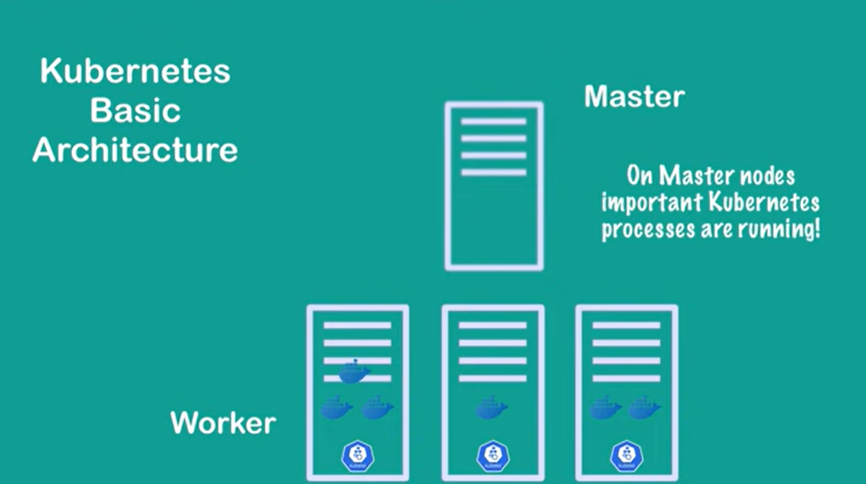

Slide 8
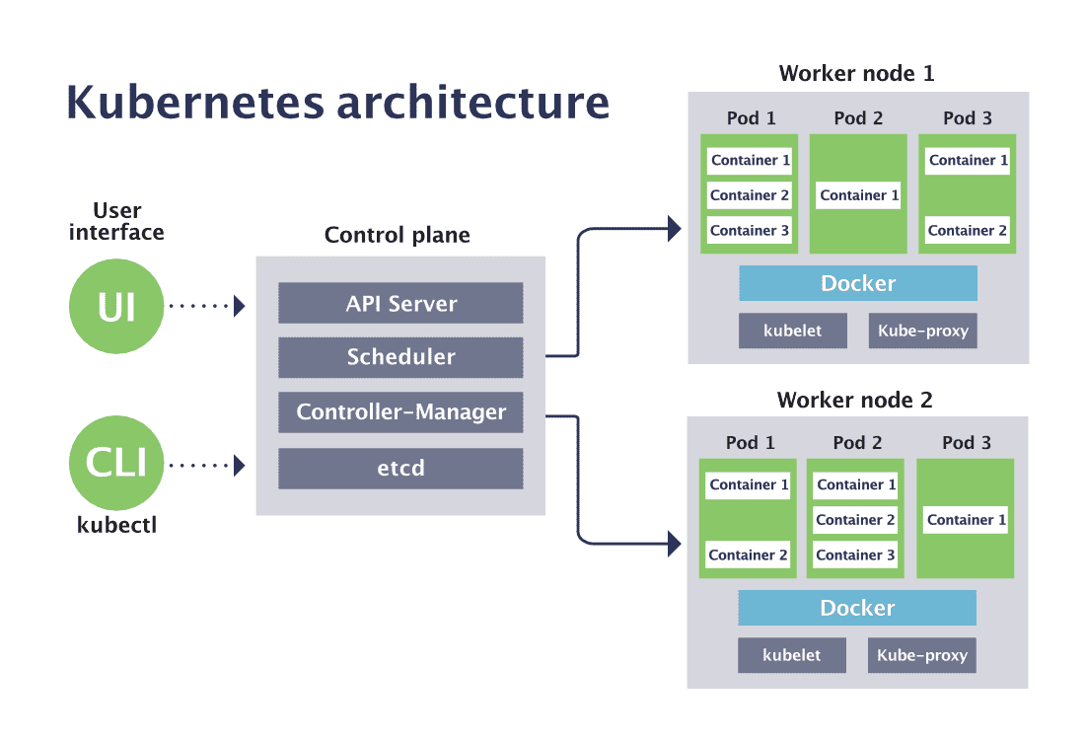
Master node

Slide 9
Kubelet Vs KubeProxy
Kubernetes Agent per Node
Manages PODs
Network Proxy Per node
Manages Services
Manages Network Rules

